Slide 1

Projet FUI 01 janvier 2012- 30 avril 2016
pour des SImulations crédibles via la COrrélation calcul-essai et l’estimation d’incertitudes en DYNamique des structures
Project pilot : EDF R&D
Sylvie Audebert
Project duration | 40 months
Total cost | 3,82 M€
OSEO financial help | 1,45 M€
FEDER financial help | 68,9 k€

Slide 2

Objectives and labellisation
Objectives:
Quantification and improvement of the credibility of numerical models in structural dynamics thanks numerical-experimental correlation and estimation of uncertainties: demonstration on an industrial structure in complex environment
Application fields: electricity production, petrol exploitation, transport and aeronautic industries
Quantity of interest : modal characteristics
Labelled by:
SYSTEMATIC
Pôle Nucléaire Bourgogne
Pôle des Microtechniques

Slide 3

The 13 partners
Large companies | ASTRIUM EADS | EDF | NECS | SULZER Pumps France
Research institutes | CETIM
Intermediate size enterprises From 250 to 2000 persons | LMS-SAMTECH | SOPEMEA
Small and medium size enterprises <250 persons | PHIMECA Engineering | VIBRATEC
Universities | ENS Cachan | FEMTO-ST | INSA Lyon | MSME

Slide 4
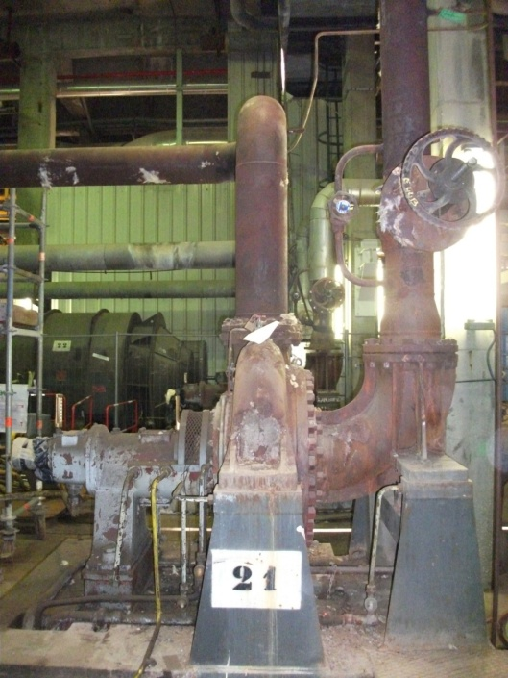
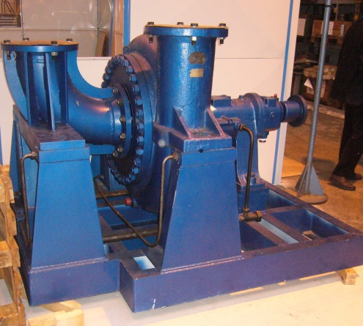
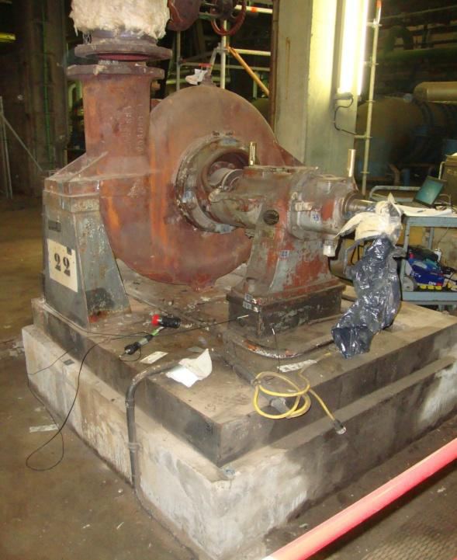
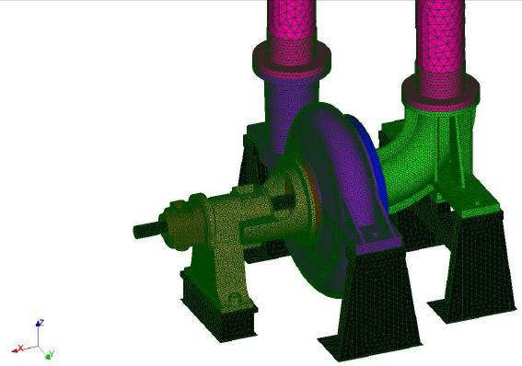
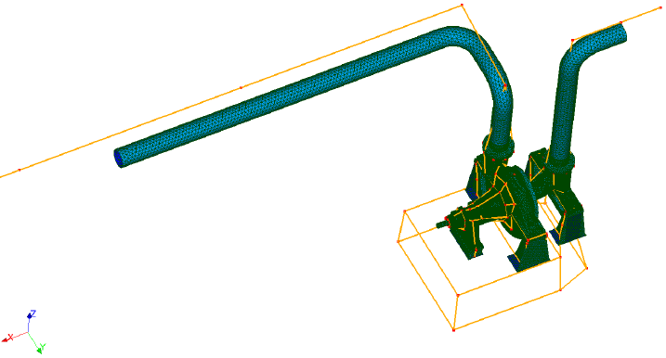
Principal demonstrator: Booster pump in industrial environment in EDF thermical plant
The Booster pump in SULZER Pumps France factory
The in situ non connected pump
In situ
The pump connected to
delivery and pipes
Modeled using finite elements

Slide 5
Scientifical structuration

Slide 6
Technological issues
Apply current methods to complex and industrial large size structures
Elaborate bolted built-up system models at macro-level
Take into account the environment
Influence of boundary conditions on the frequency response
Perform the best compromise between fidelity of computational results to test data and robustness of numerical models regarding uncertainties

Slide 7
Scientific innovations
1
Illustration of the complete procedure 1) modeling at macro-level, 2) a priori estimation of uncertainties, 3) measurement, 4) test-analysis correlation, 5) model credibility
2
Application of methods tested on academic examples on a complex structure in industrial environment
3
4
Observation of the total numerical variability by reproducing the real conditions of a study conducted by a design office (benchmarks)
5
Observation of the experimental variability on an in situ industrial system in situ (benchmarks)
Development and application of methods to quantify the total numerical uncertainty (parametrical + model form uncertainty)
6
Evaluation of the capacity of methods to quantify the total numerical uncertainty by comparison with the observed variability thanks to benchmarking operations
7
Determination of security coefficients and confidence intervals depending on problem classification

Slide 8
SICODYN Benchmark Surrogate modeling
Karina Macocco & Felipe Aguirre
Phimeca Engineering

Slide 9
Scientifical structuration
Part
2
Part
3
Observation
of the
Observation
of the
total
experimental variability
num
e
rical variability
(benchmark)
(benchmark)
Part
1
Part
State of the art
4
Test
-
analysis correlation
“best
compromise
” model
Methods
Tool
box
Part
5
Analysis of the numerical
Part
variability via
confrontation
6
of
Comparison of observed and
methods to quantify uncertainties
simulated numerical
variabilities
Classification
-
capitalisation
Benchmark data
base
Security
coefficients
12/06/2015 (F. Aguirre & K. Macocco)

Slide 10
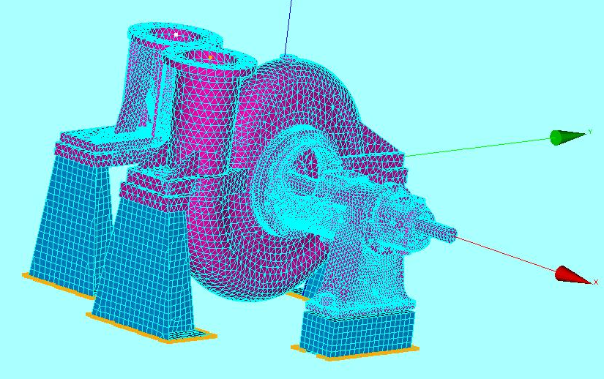


Study of the pump casing – variables & definition domain
Study of the pump casing – variables & definition domain
Uncertain parameters are the radius of the connecting screws of the frame with the other elements.
Uniform distributions
Radius type 1 [m] : [0,0088 ; 0,0132]
Radius type 2 [m] : [0,011088 ; 0,016632]
Radius type 3 [m] : [0,011088 ; 0,016632]
400 training points and 100 testing points
1h30 minutes per simulation with high RAM consumption (10 GB).
Total simulation time :
25 days for the training points reduced to one day if distributed with Simulagora)
6,25 days for the testing points (Distributed at Phimeca over 3 cores)
Notes:
Meta-modele base d’apprentissage 400 points, base de test 100 utilise (plan de test) 6.25 sequentiel
2 jours Simulagora (20 machines) ou 2heures

Slide 11
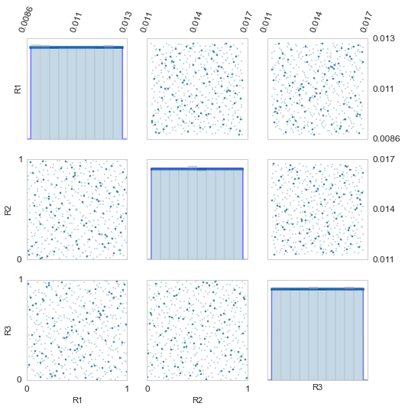
Input of the design of experiment
Sobol Sequence
400 points for the training dataset.
LHS
100 points for the testing dataset. Highlighted in the graph.
Notes:
Quelles différences? Point gras point de test (signification)? R1 fixé => R2 et R3 aléatoire loi uniforme
Loi jointe R1/R2. Deux manières de constrution de plan d’expérience . Facilité d’enrichissement du plan

Slide 12
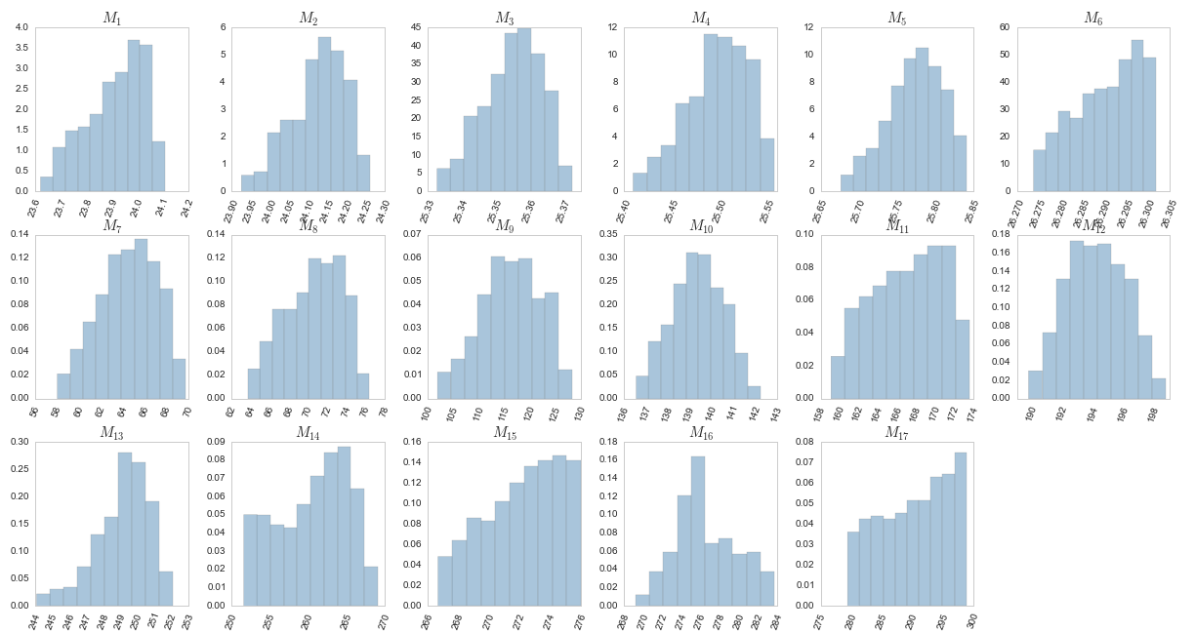

Output of the design of experiment
Frequencies
Notes:
Propagation des incertitudes. Quand uniforme? Linéaire?

Slide 13
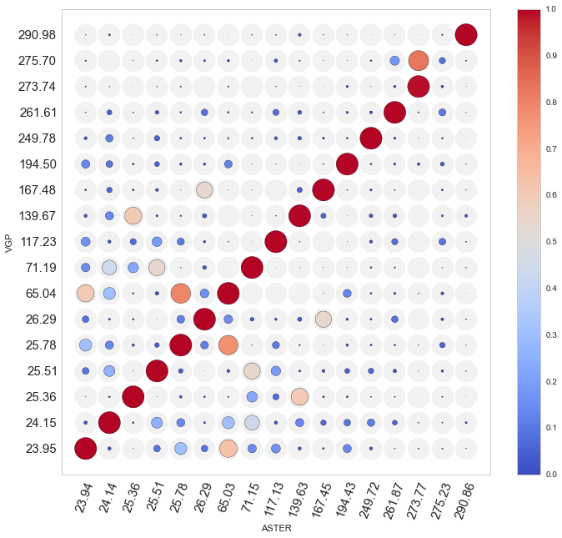
MAC matrix of the VGP
Notes:
Métamodèle? Comparaison vis-à-vis du nominal les deux

Slide 14
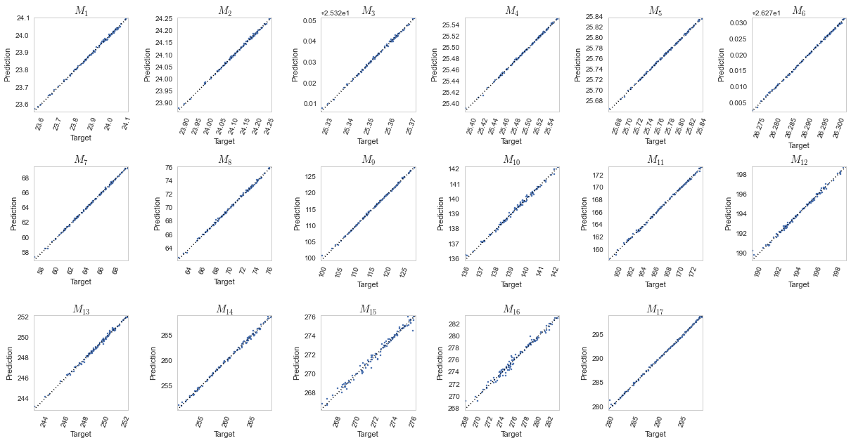
Adjustment graph of the VGP
Notes:
Comparaison Méta-modèle modèle test 100 graphe d’ajustement.

Slide 15
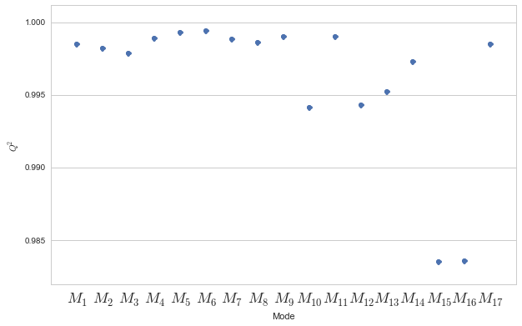
Validation of the VGP
Notes:
Indicateurs?

Slide 16
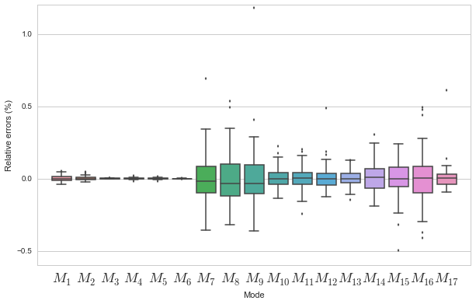
Validation of the VGP
Notes:
Erreurs relatives, moyennes écart type et ? 7, 8 et 9. Points? (Verité – prédiction)/Vérité*100

Slide 17
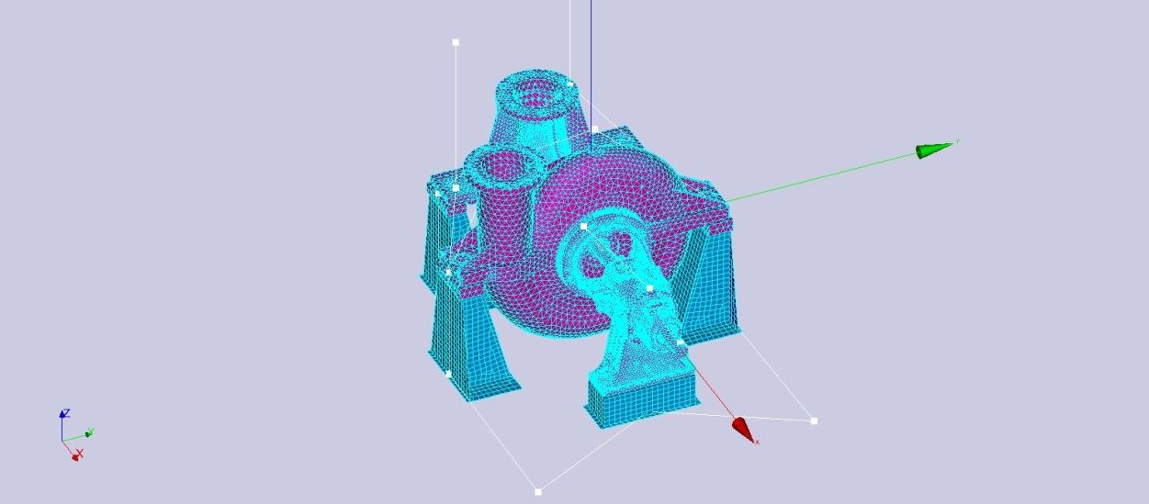
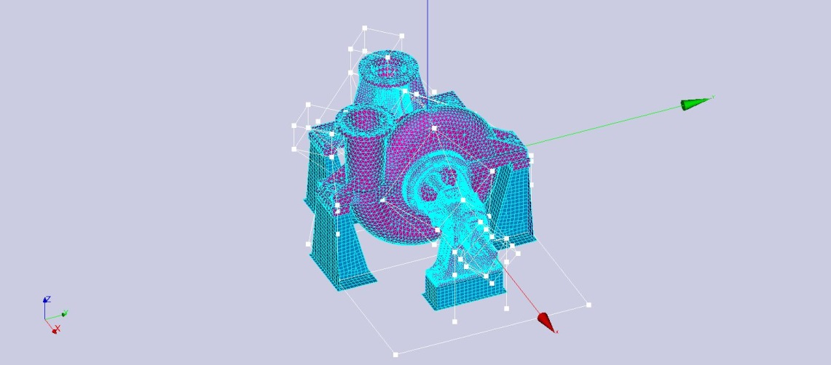
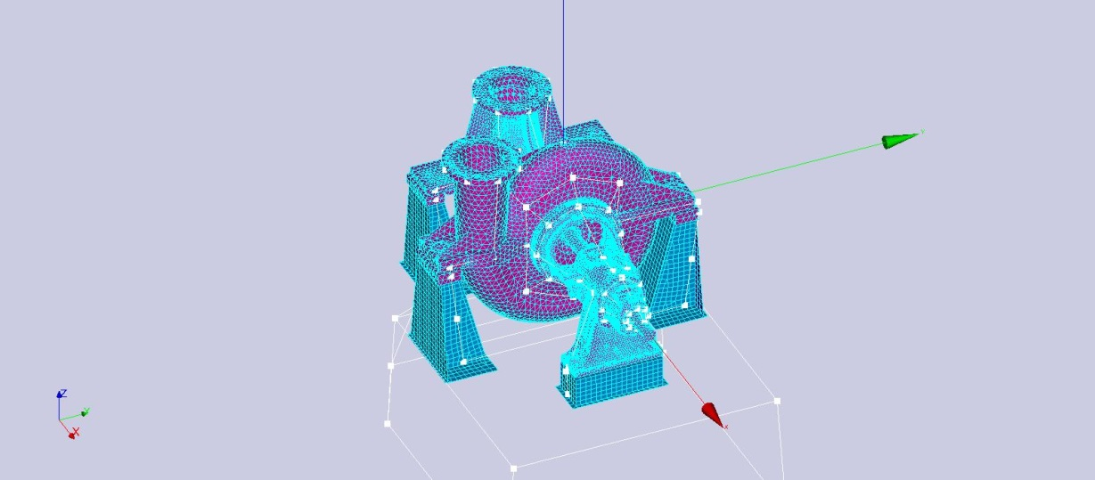
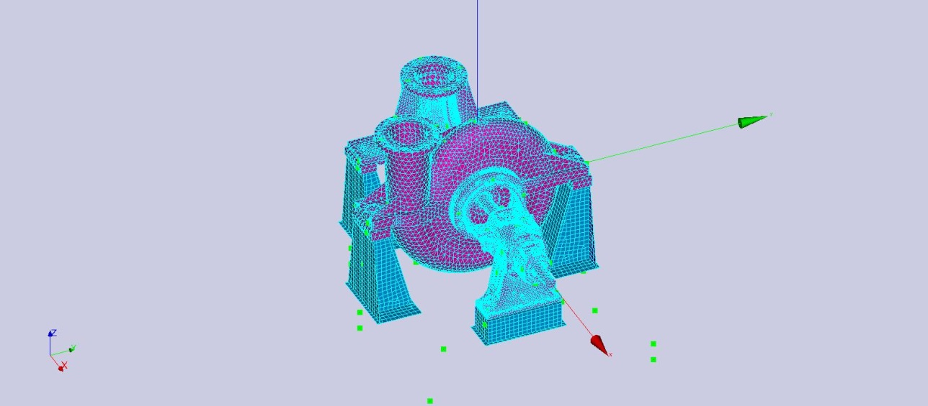
Perspectives
Bayesien

